Slide 1
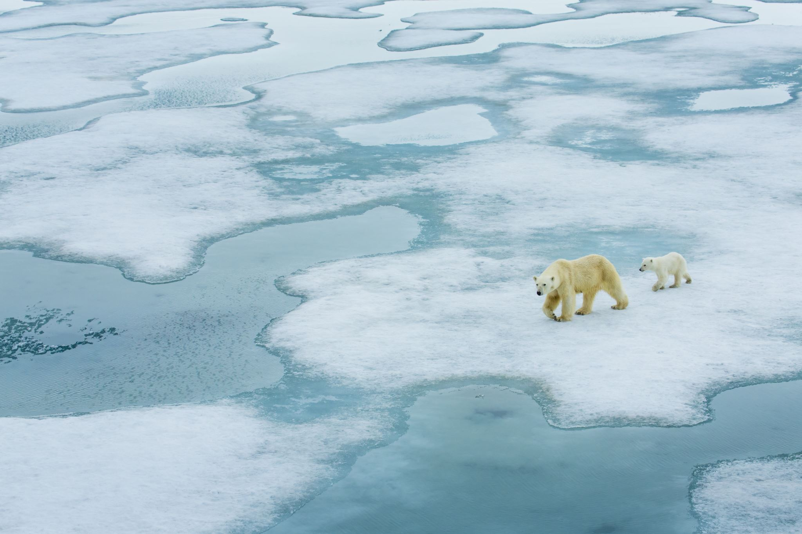
Adapting to a Changing World:
Unveiling the Story of Polar Bears and Climate Shifts
Nick Nath, Paolo Arciaga, Mari Awaisi, Krystin Cipriano

Slide 2
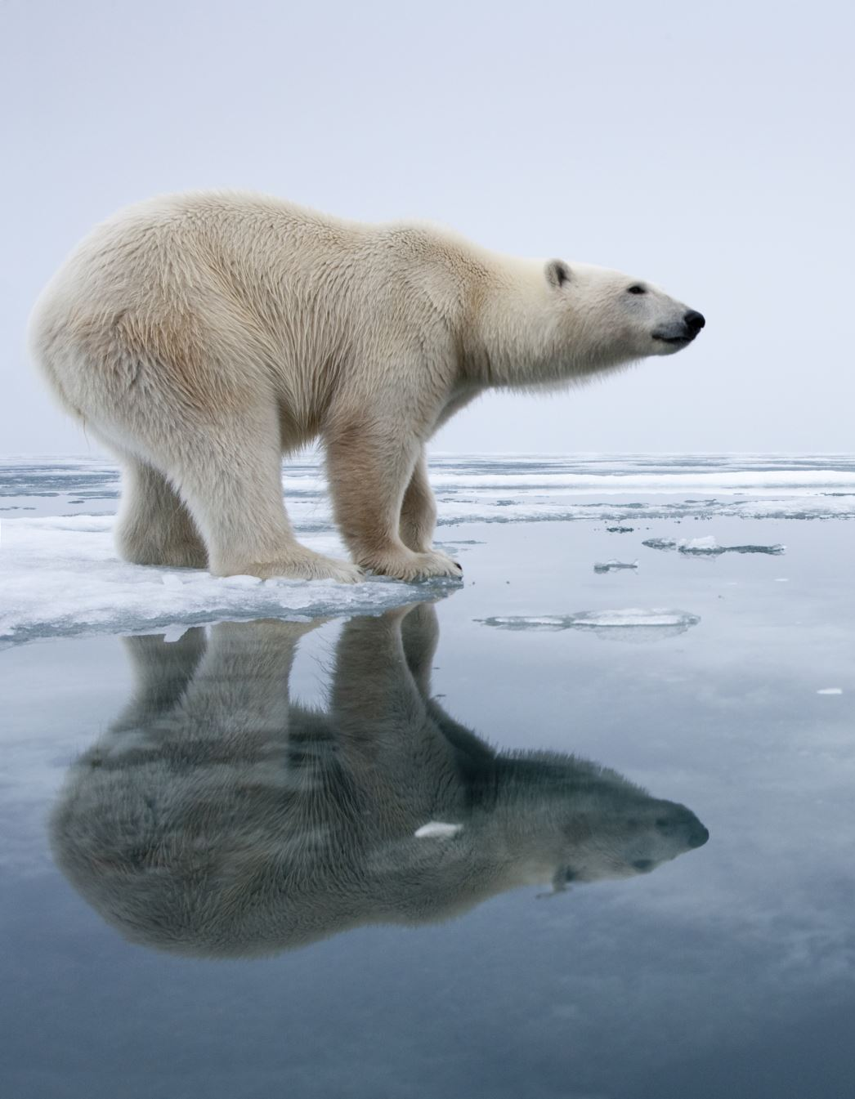
Introduction
Extrapolate polar bear physiological data on age , mass and offspring viability to show trend with rising temperatures.
Longitudinal study of temperature change in the Arctic habitat of Beaufort Sea.
Gather insights into the health and physiology of polar bears.
Findings can be used to raise awareness about the impact of climate change on polar bears.

Slide 3
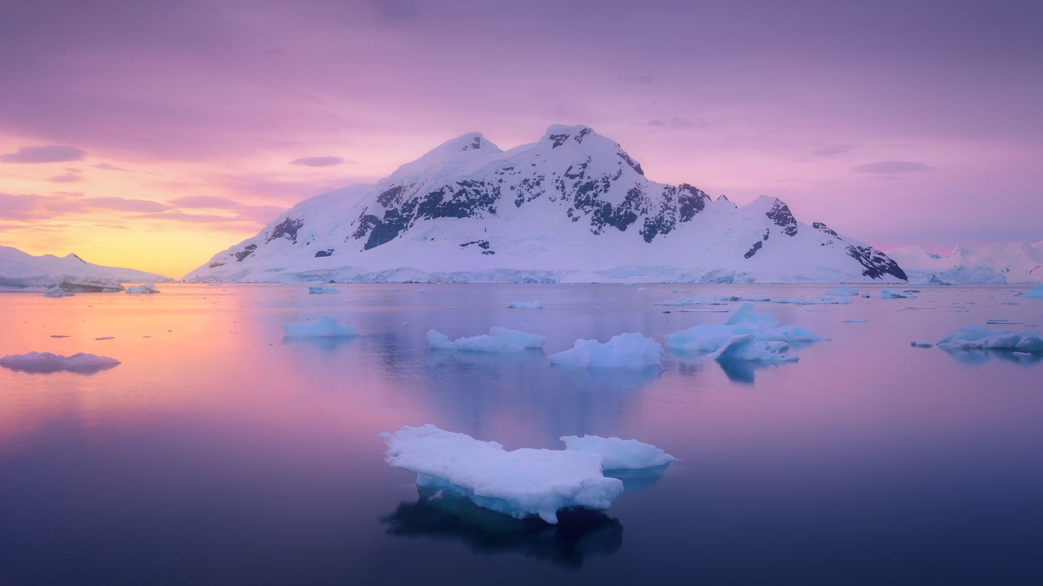
Project Data Background (1981-2017)
Dataset # 1: A 36-year longitudinal study of polar bear population measurements:
Age
Mass
Total length
Number of cubs
Body Fat samples
Dataset # 2: Temperatures in the Arctic region of Southern Beaufort Seas
Average yearly temperature
Maximum temperature
Study Appendix:
OpenWeather Marketplace (openweathermap.org)
ASC Data (usgs.gov)

Slide 4
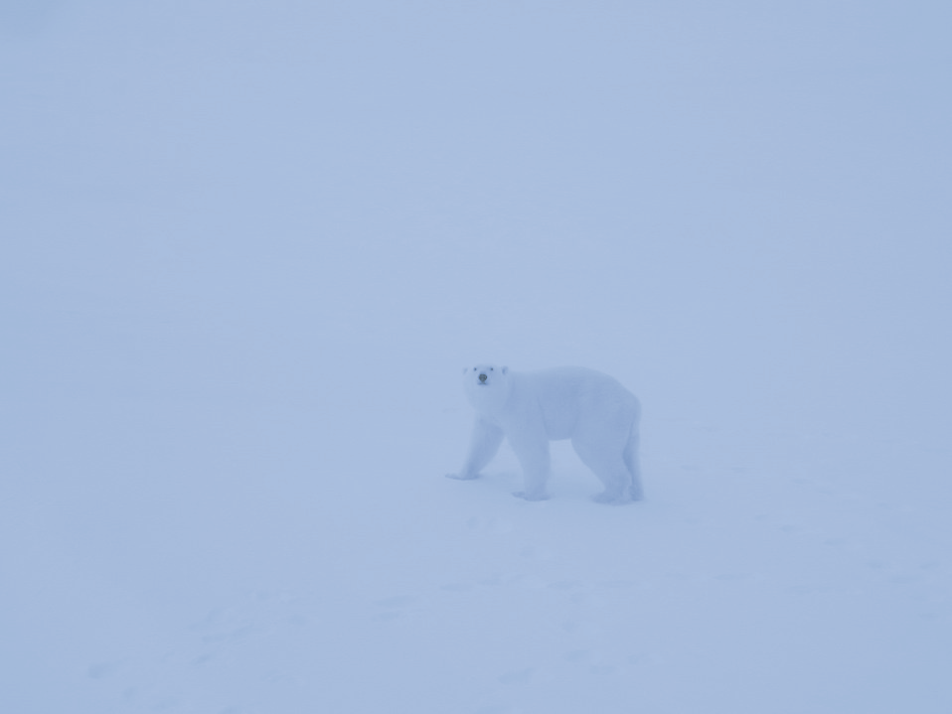
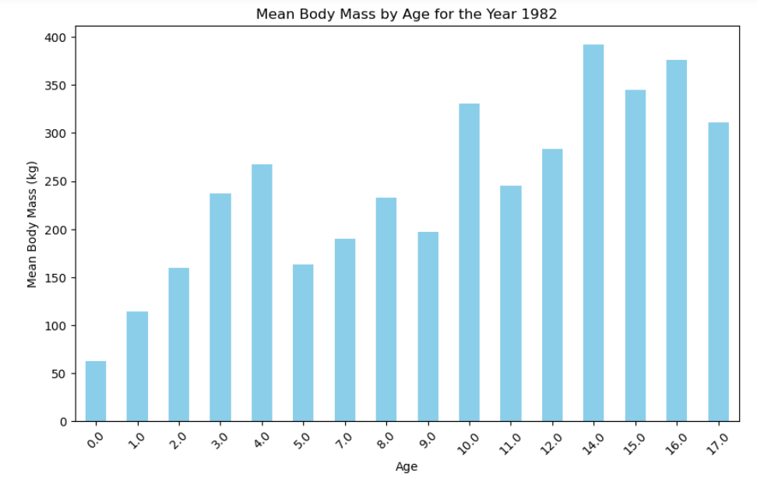
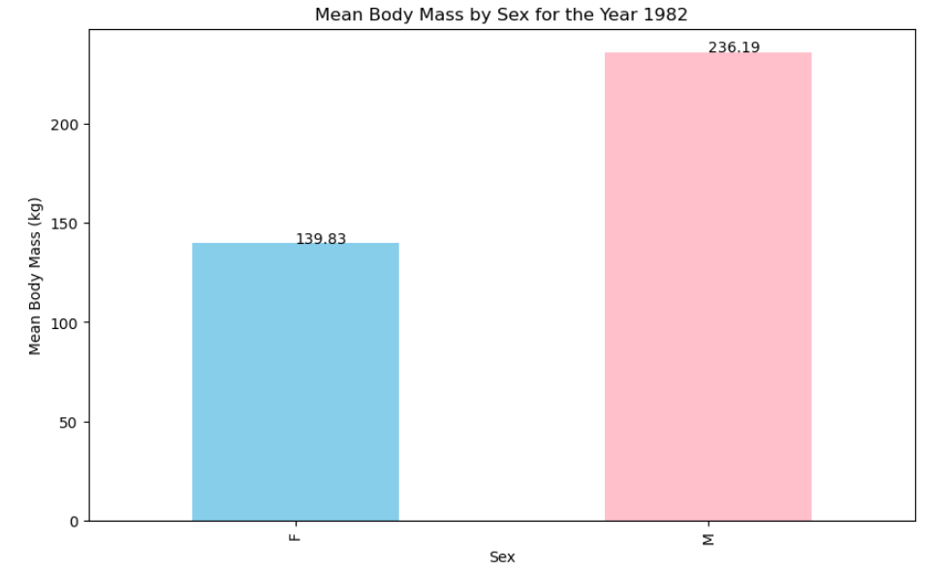
Mean Body Mass Dataset # 1: Beginning of Study (1982)
Age-Related Growth - peak in mean body mass ages 10-14 years.
Decline in mass over peak age.
Natural decline with aging or variability in health & nutrition of older bears.
This data is used as a baseline to compare how polar bear population has been affected over time by factors such as climate change and human activity.
Study Appendix: ASC Data (usgs.gov)

Slide 5
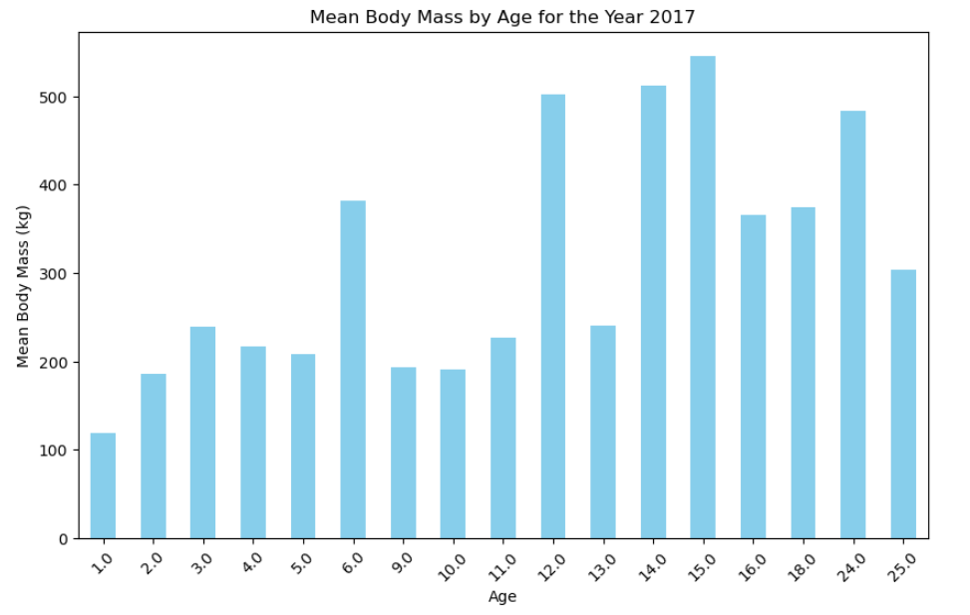
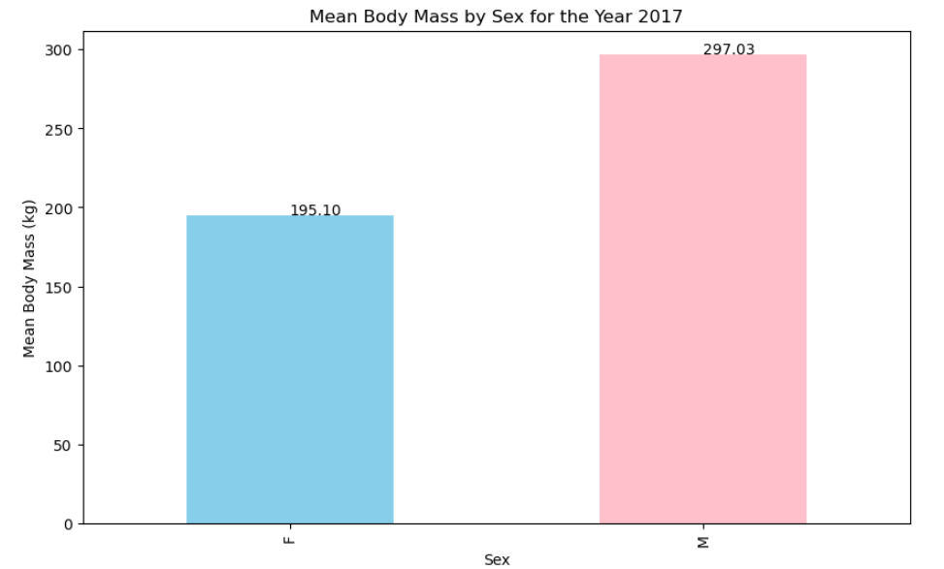
Mean Body Mass Dataset # 1: End of Study (2017)
Polar bears are reaching higher mean masses in 2017 vs. 1982.
Higher younger bear mass (ages 0-5) indicate improved juvenile survival/better early life nutrition.
Middle age groups experiencing lower mean masses which could point to environmental factors.
Female polar bears have a lower mean body mass. Highlights the pronounced sexual dimorphism in polar bears, which is a common observation in this species.
Body mass has increased on average by ~60 kg males & ~55 kg females.
Study Appendix: ASC Data (usgs.gov)

Slide 6
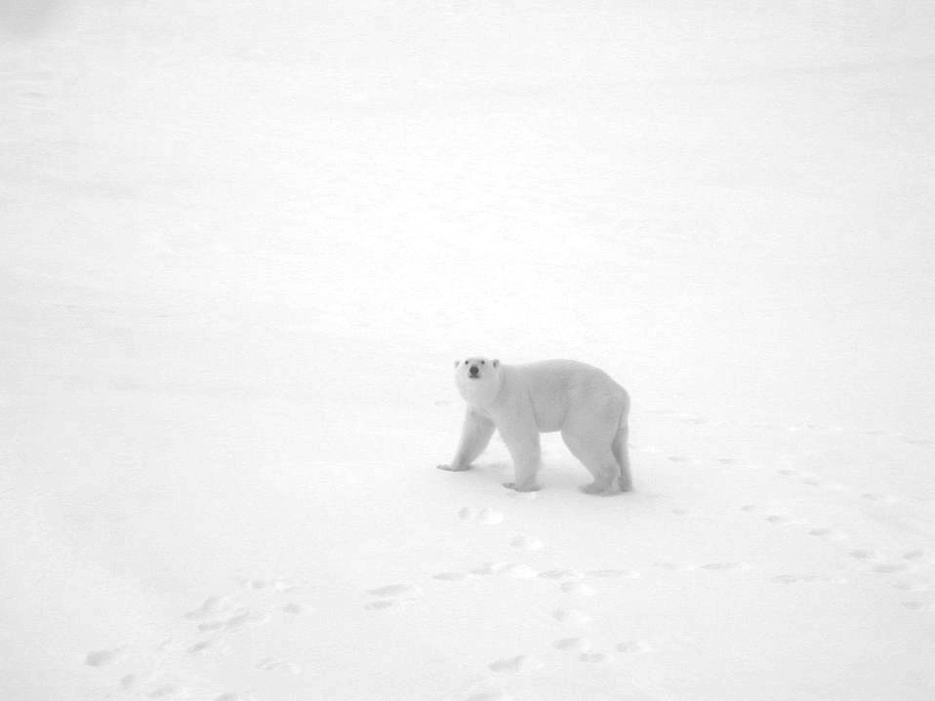
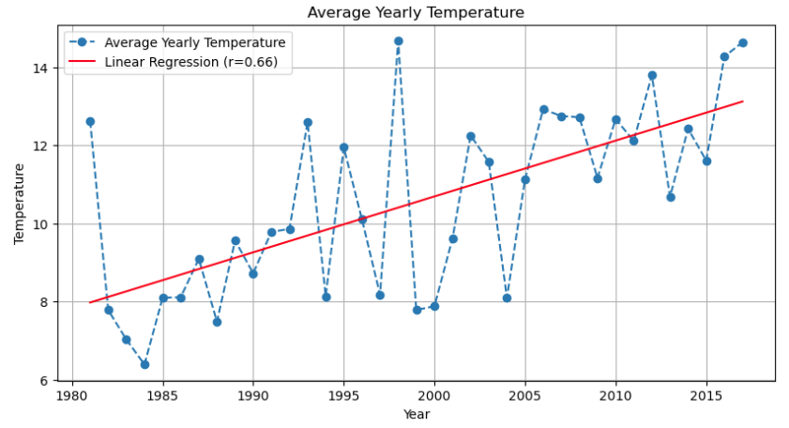
Average Yearly Temperature over a 36 year period: Beaufort Sea
Upward Trend in Temperature:
Upward trend in the average yearly temperature, indicates a warming climate in the Beaufort Sea region over the period studied.
Significant Variability:
Significant year-to-year variability, suggests that regional temperatures are subject to a wide range of influencing factors.
Correlation with Global Warming:
The positive slope of the linear regression line, with a correlation coefficient of 0.66, is relatively strong, implying a possible link with global warming trends.
Study Appendix: OpenWeather Marketplace (openweathermap.org)

Slide 7
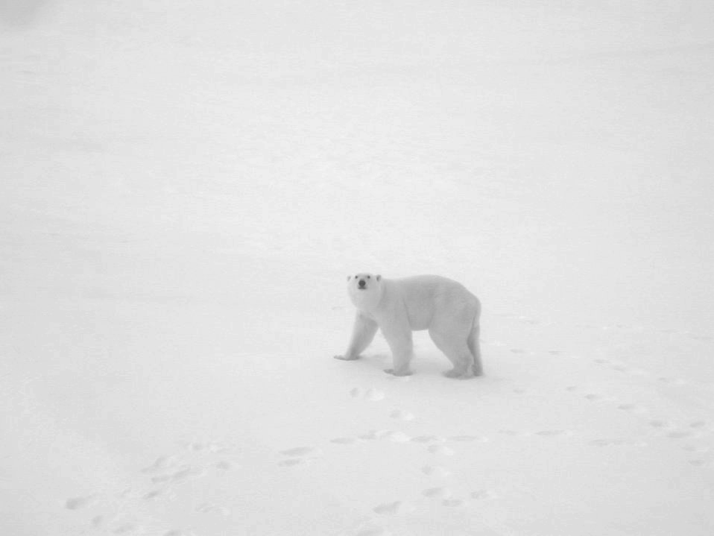
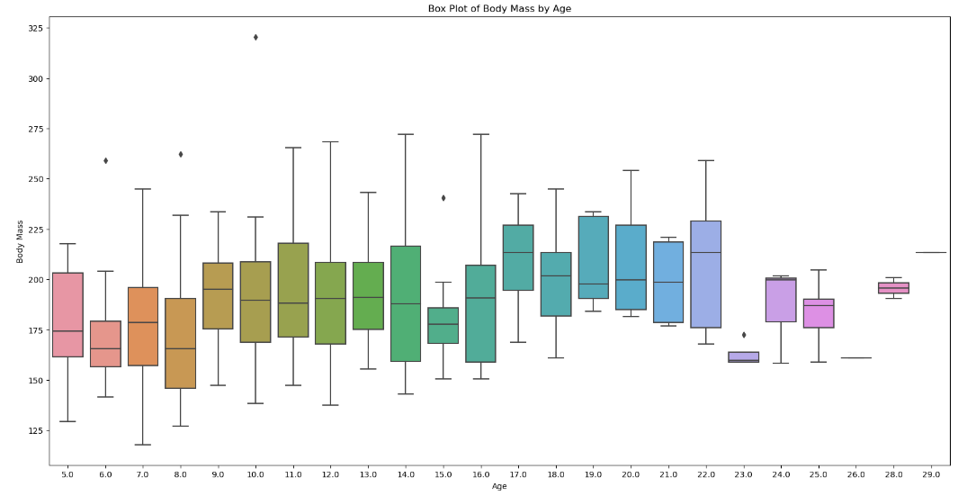
Polar Bear Population: A Snapshot of Body Mass over Time
= Outliers
Outliers and Health Indicators:
The presence of outliers, in younger and older age groups, may indicate health disparities or exceptional cases that could warrant further investigation.
Older Bear Variation:
Beyond the age of 20, there is a noticeable decrease in both the median and variability of body mass, which could be due to age-related factors affecting the bears' health or ability to hunt.

Slide 8
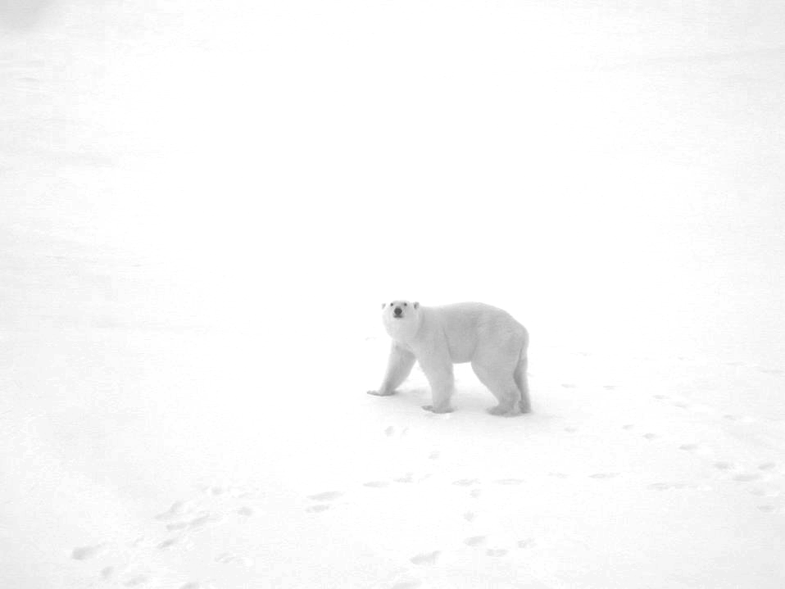
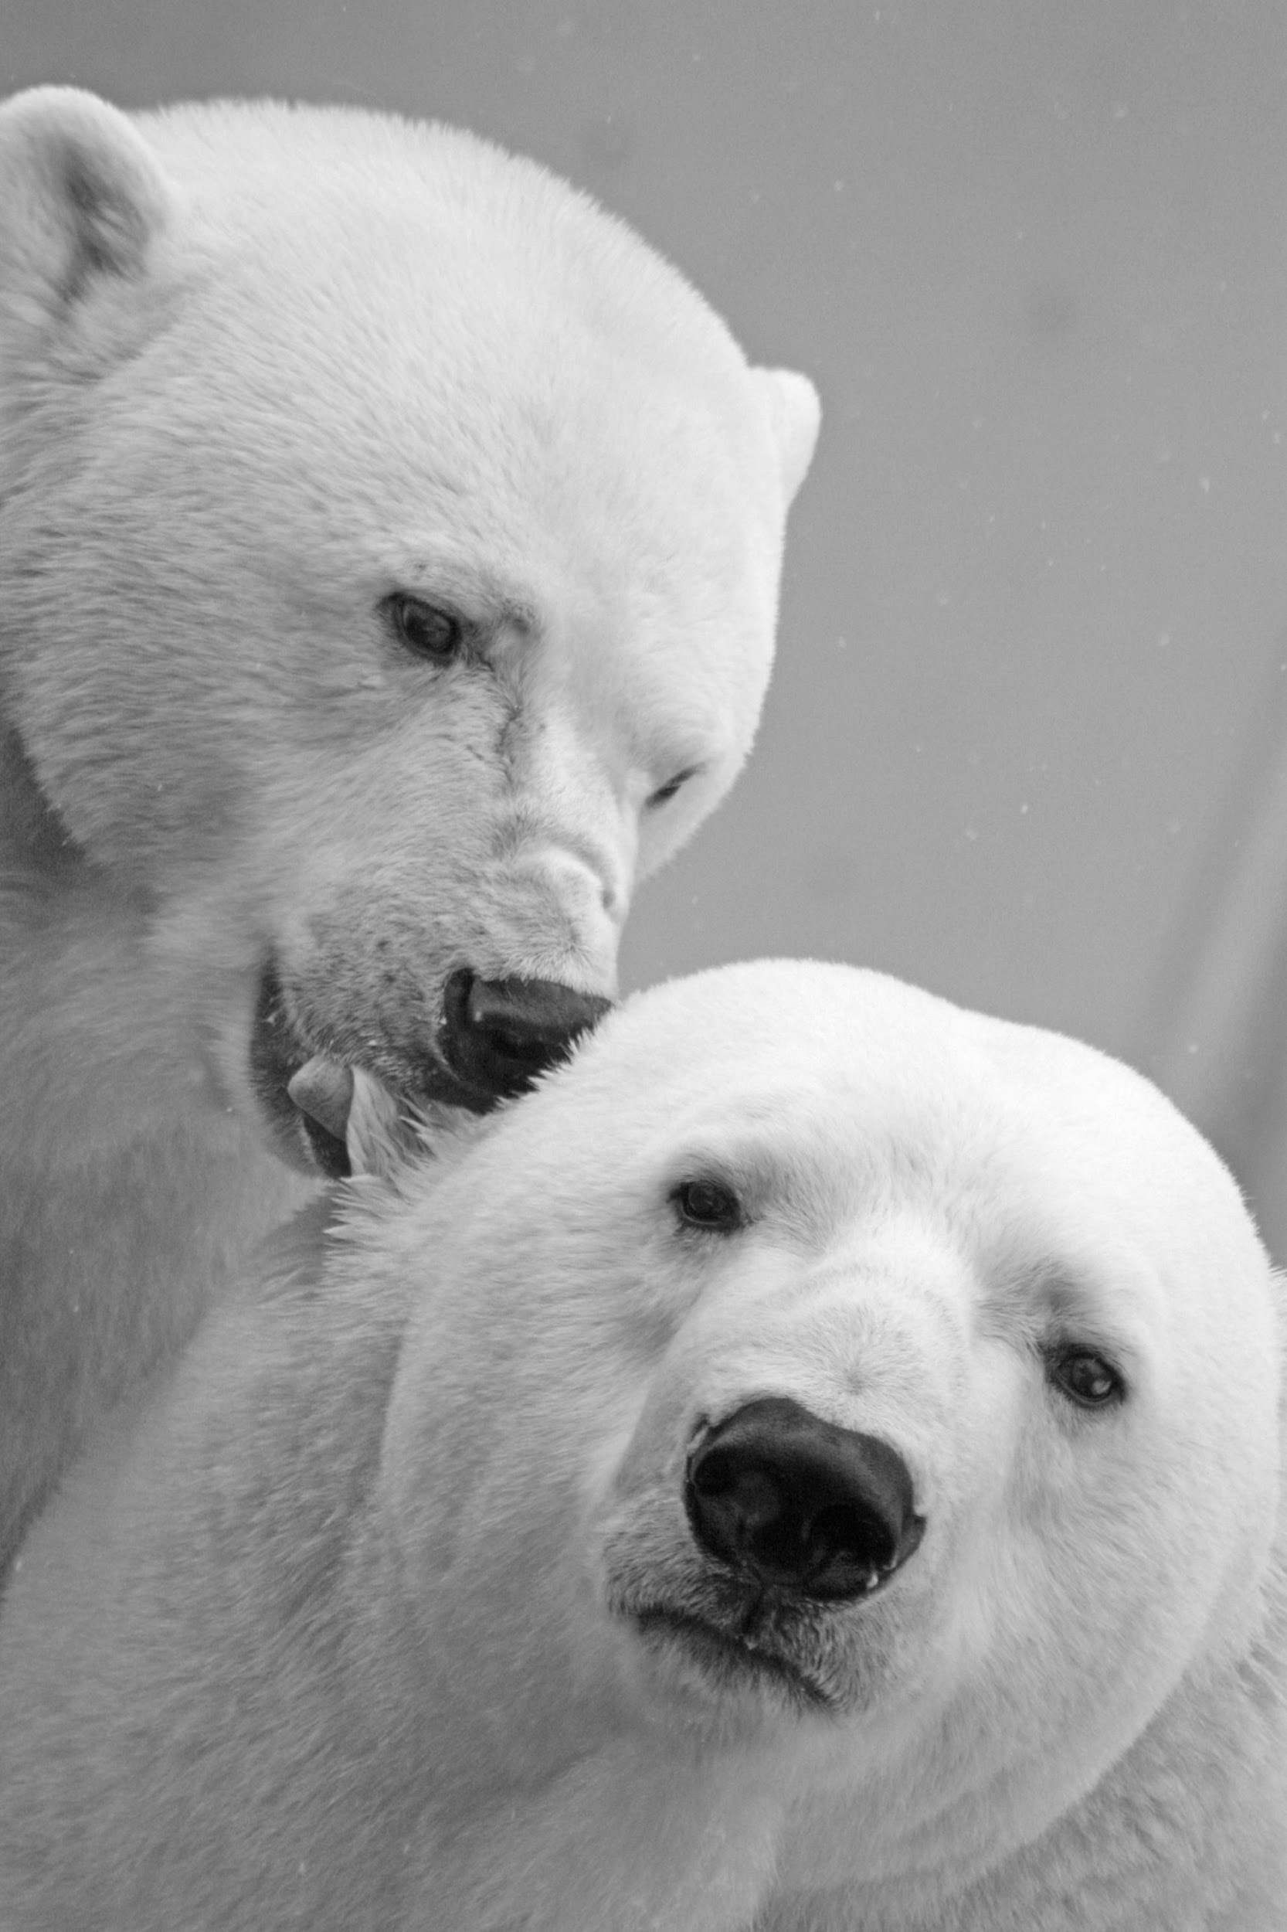
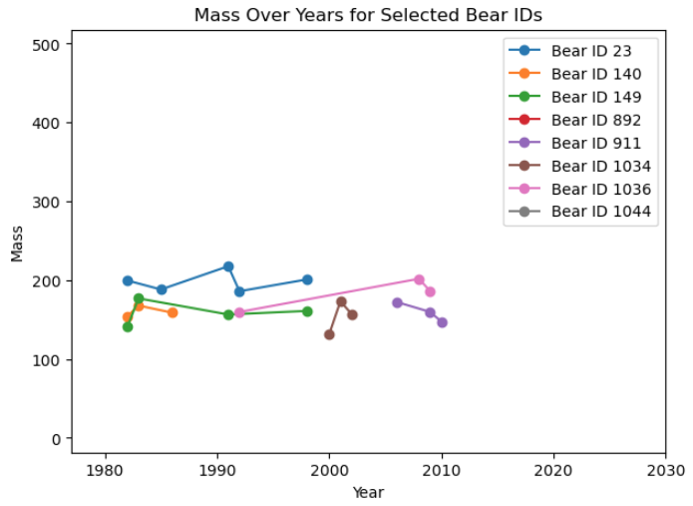
Polar Bear Population (Sample)
After 2010, there is a general downward trend in mass across multiple bears, which could be associated with broader ecological changes affecting the Arctic, such as reduced sea ice extent and its impact on the availability of prey. This trend is concerning for polar bear health and underscores the importance of ongoing monitoring and conservation efforts.

Slide 9
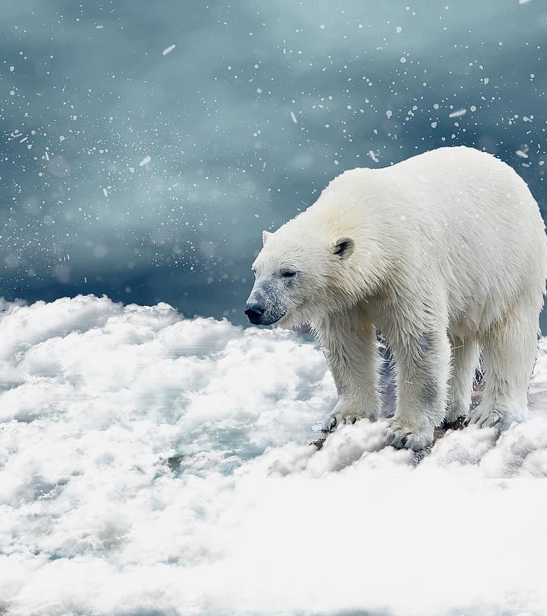
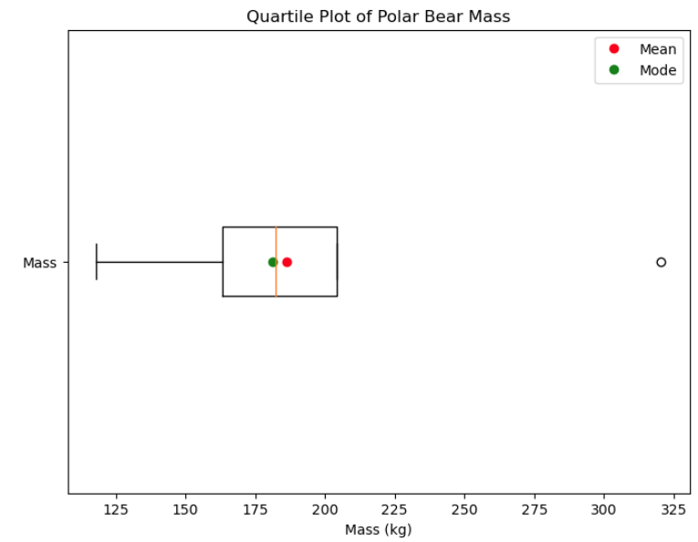
Visual Summary of Physical Condition
Nutritional Stress:
Left whisker around 118 kg, might reflect nutritional stress linked to the longer ice-free seasons and changing prey availability associated with a warming climate.
Adaptation and Resilience:
Mean and mode marked on the plot, suggests variability in the population's response to environmental stressors.

Slide 10
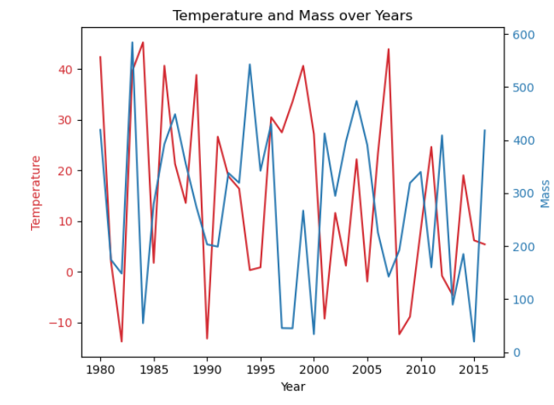
Temperature & Mass over a 36 year period: Beaufort Sea
During certain periods, a rise in temperature coincides with a decrease in mass, possibly reflecting the impact of a warming climate on polar bear habitats and food sources. However, the relationship is not strictly entirely inverse; there are years where both temperature and mass increase, suggesting other ecological or biological factors at play.
Points of Interest: Years where temperature is higher than body mass: 1985-1986
1988-1989
1996-2001
2005-2007
2013-2015
*Estimate 11 years when temp exceeds mass.
Study Appendix: OpenWeather Marketplace (openweathermap.org)
ASC Data (usgs.gov)

Slide 11
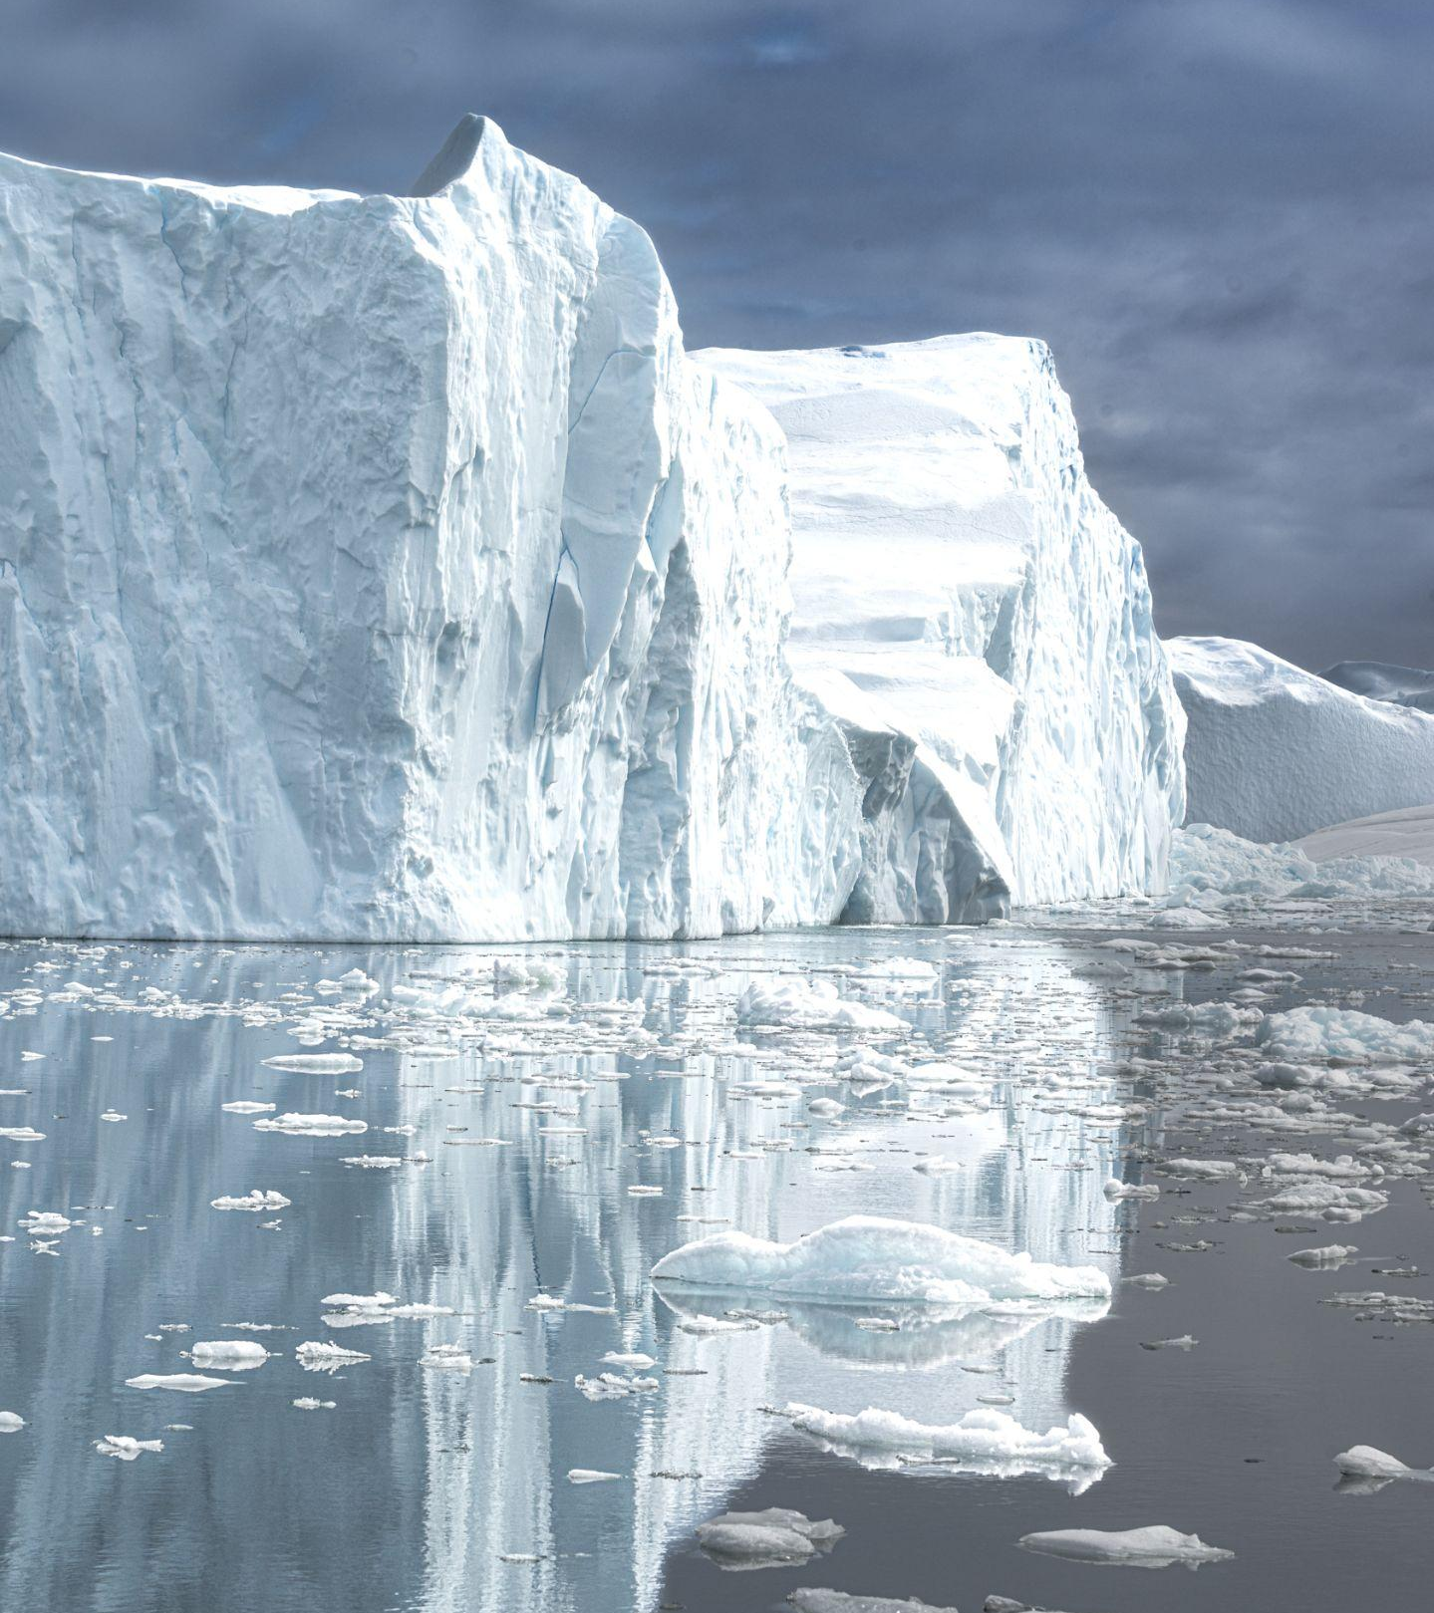
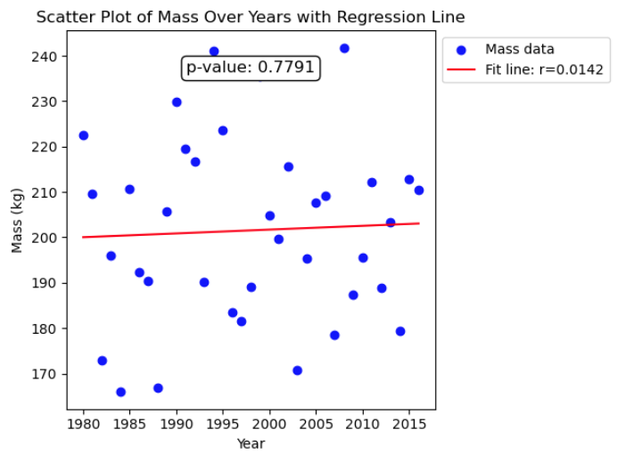
Statistical Test: Pearson’s Correlation for Linear Relationship between Mass and Year
Correlation Coefficient:The correlation coefficient is 0.014
P-value: The p-value obtained from the test is approximately 0.779, which is much higher than the conventional alpha level of 0.05. This suggests that the observed correlation (or lack thereof) could very likely be due to random chance rather than a significant linear relationship.
Statistical Conclusion: We fail to reject our null hypothesis

Slide 12
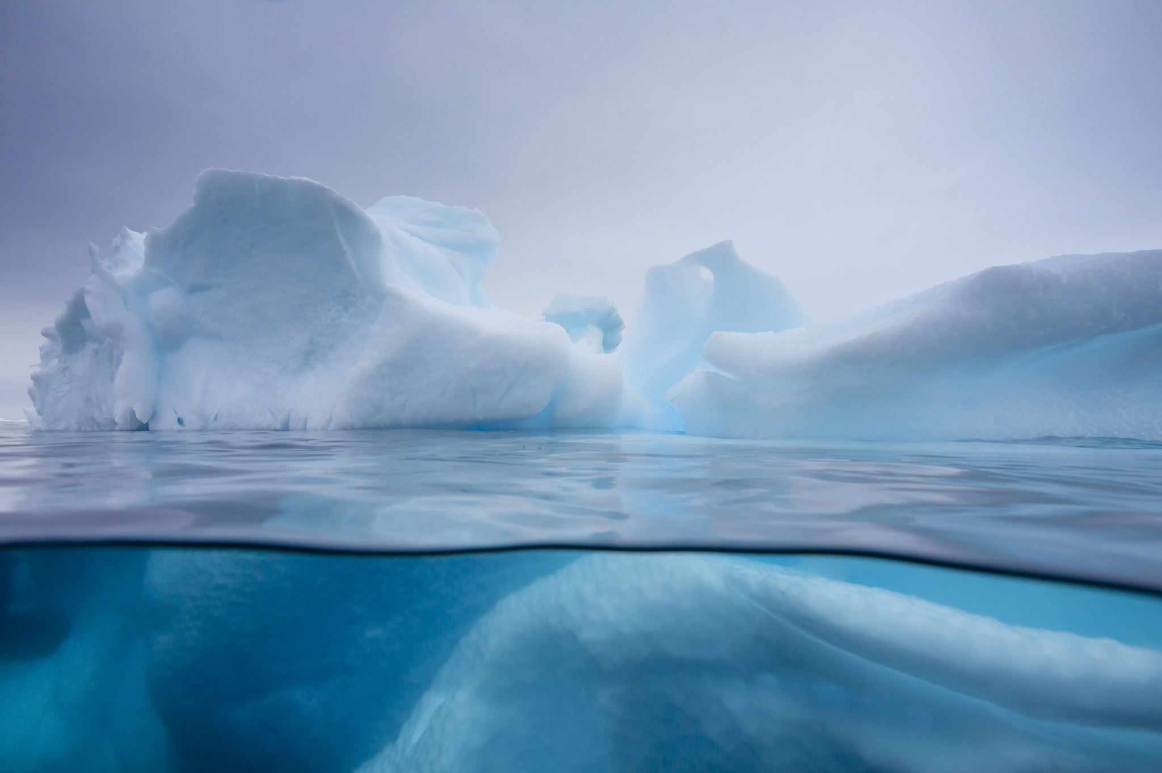
Conclusion Analysis: Part I- We need more data…
Insufficient Data on the cubs’ body mass & age
Body Mass does not indicate or correlate to level of health.
Lack of data on Gut fill, Fat in Adipose tissue: Implications on how many seals are available for food.
Blubber- dense energy reserves that bears need to survive.
Lack of Sea level data: Rising sea levels can contribute to changes in sea ice dynamics, such as the formation, thickness, and extent of sea ice.
Hunting for seals - Directly impacts polar bear behavior and survival.

Slide 13
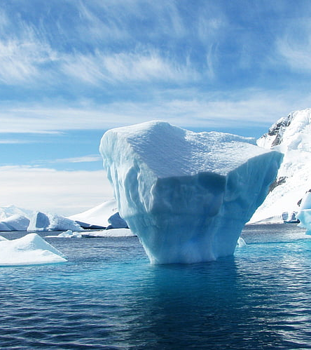
Drawing Conclusion on Polar Bear Health & Climate Change
Impact of Temperature on Habitat
Nutritional Stress
Age-Related Trends
Long-Term Survival
**It's important to note that while statistical correlations can highlight potential relationships, they do not establish causation.**

Slide 14
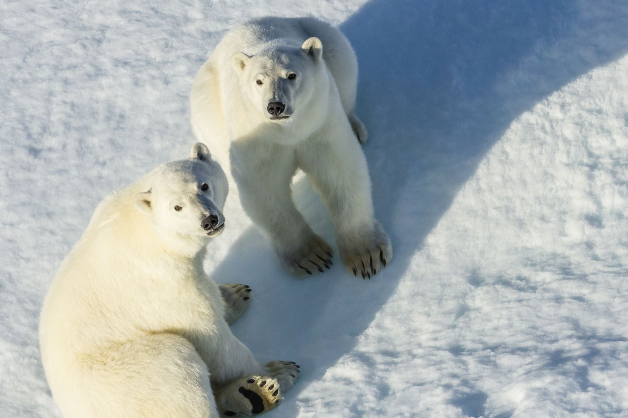
Conservation Efforts
Prey Conservation:
Implement measures to conserve seal populations, ensuring that polar bears have sufficient food resources.
Public Education and Outreach:
Promote energy conservation and sustainable living practices that can contribute to climate change mitigation.
Climate Change Mitigation:
Address global warming by reducing greenhouse gas emissions. Effort to slow down or reverse the loss of sea ice habitat critical for polar bear survival.

Slide 15
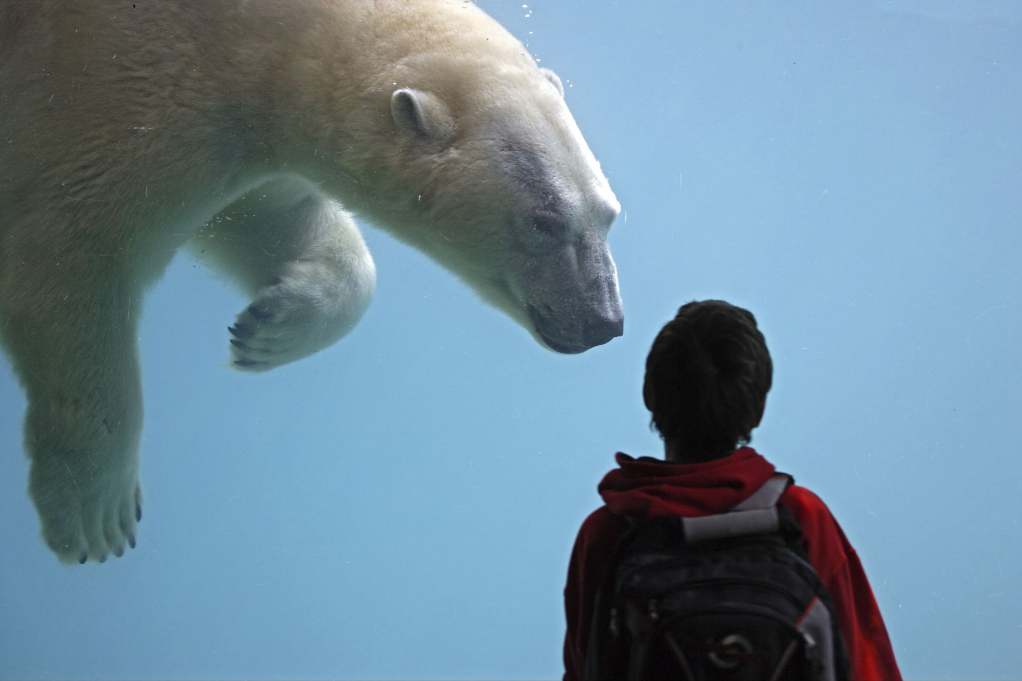
Questions?

